Slide 1
ANDROID APPLICATION DEVELOPMENT OF FAREDGE Six weeks Industrial Training Report at NUCLEUS SOFTWARE EXPORTS
Thanku :-
Mr Parag Bise for his guidance , support and patience throughout project

Slide 2

INDEX
WHAT IS ANDROID STUDIO AND WHAT IS FAR EDGE??
WORKING OF PROJECT
HARDWARE AND SOFTWARE USED
FLOW CHART OF WORKING
START OF ANDROID APPLICATION
SCREENSHOT OF OUTPUTS
VIDEO ON WORKING
CONCLUSION
FUTURE WORK

Slide 3
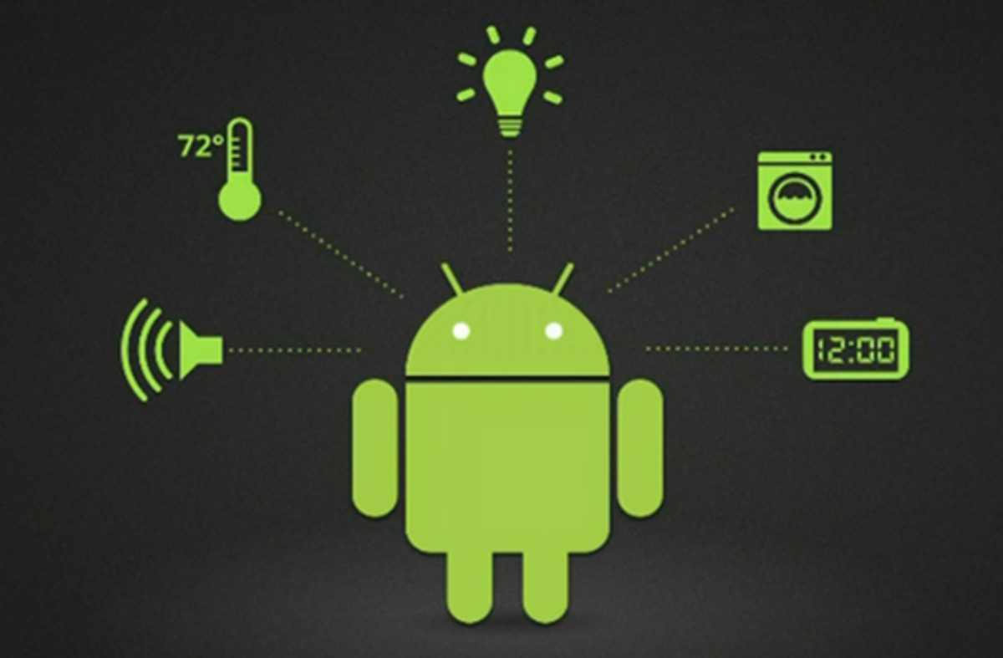
What is Android studio ? & What is Far Edge?
ANDROID STUDIO
Android Studio is the official integrated development environment (IDE) for Google's Android operating system. It is used for developing mobile application which works to complete need of android user
FAREDGE APPLICATION
Purpose of creating this “FAREDGE APPLICATION” is a built-in "intelligent assistant" that enables users to get answer to all their question without typing questions we can speak natural language voice commands in order to operate the mobile device and get answers. Users can speak commands -- and receive audible confirmation from FAREDGE.

Slide 4
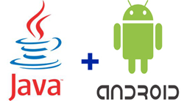
WORKING OF PROJECT??
This is a project combination of android studio and java eclipse both combine to form an android application called as”FAREDGE APPLICATION” it is an application with GUI interface
It is user interactive application where user can talk to the application and ask any question for answer whereas while asking question user convert the speech to text and then this question is send to server by hitting URL by get or post method if request type matches server then a certification is formed
After that the question is send to our server and there string matching is performed if answer is found out on the server then the answer is brought to mobile screen in a text format which is then converted to speech

Slide 5

Hardware used
64 bit windows 8
4 GB RAM
Software used
Android studio 2.3.3
Jar files
Eclipse
Tomcat 7

Slide 6
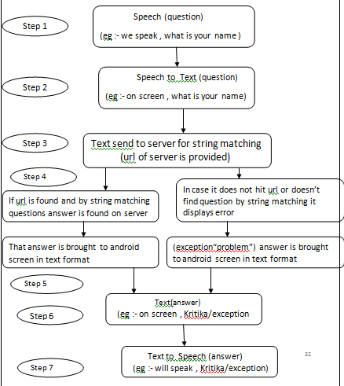
Flow chart of working

Slide 7
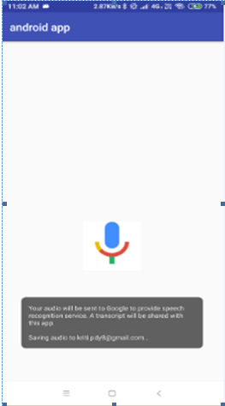
Start up of android studio application

Slide 8
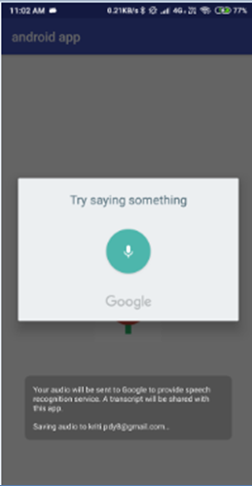
Tap to speak option

Slide 9
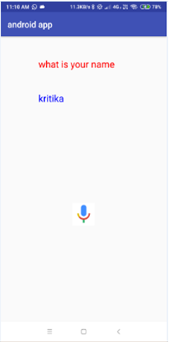
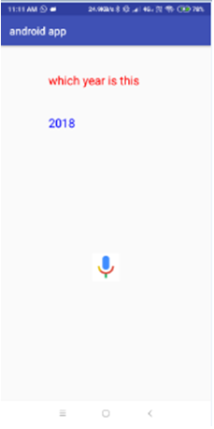
Screenshot of Output

Slide 10
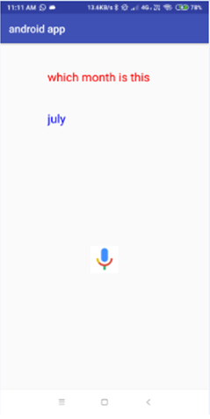
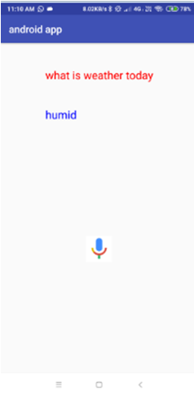
Screenshot of Output

Slide 11
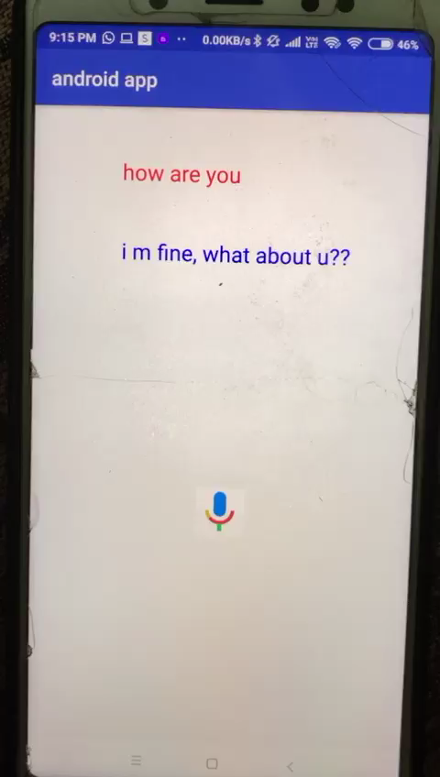
VIDEO

Slide 12
CONCLUSION
This is an application which is helpful for both the kind of people who are blind or deaf
As it work in all languages it can be used in any part of the world
Even illiterate can take its help
Now it answer limited question but after enhancement it can become universal and can answer all question
Conclusion is that this app use question answer format on answering any question it answers it in text as well as spoken form

Slide 13
FUTURE WORK
There is an scope of further enhancement
Upload pictures
Upload files
Voice reading of files
Download picture
Create history backup
Music upload &download
For now its limited it answers few question but as chatpot is in process then it will be able to answer all question in all languages of world

Slide 14


THANK YOU
Submitted by :- Kritika Pandey
Roll Number :- 40155102715
BRANCH :- B.Tech , CSE
YEAR :- 4 YEAR ,7 SEM

